Slide 1
What’s new in .NET
ADrian Stanula

Slide 2
What's new in .NET Platform

Slide 3
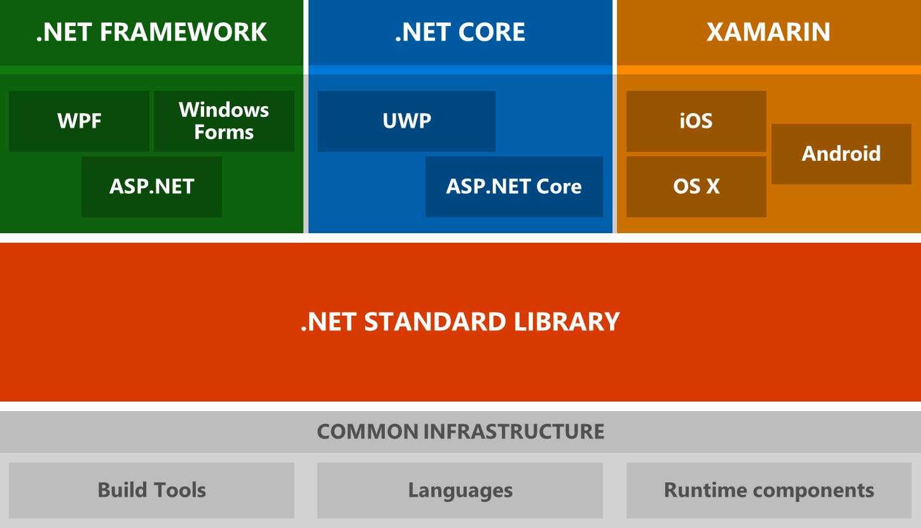
.NET Architectural Components

Slide 4
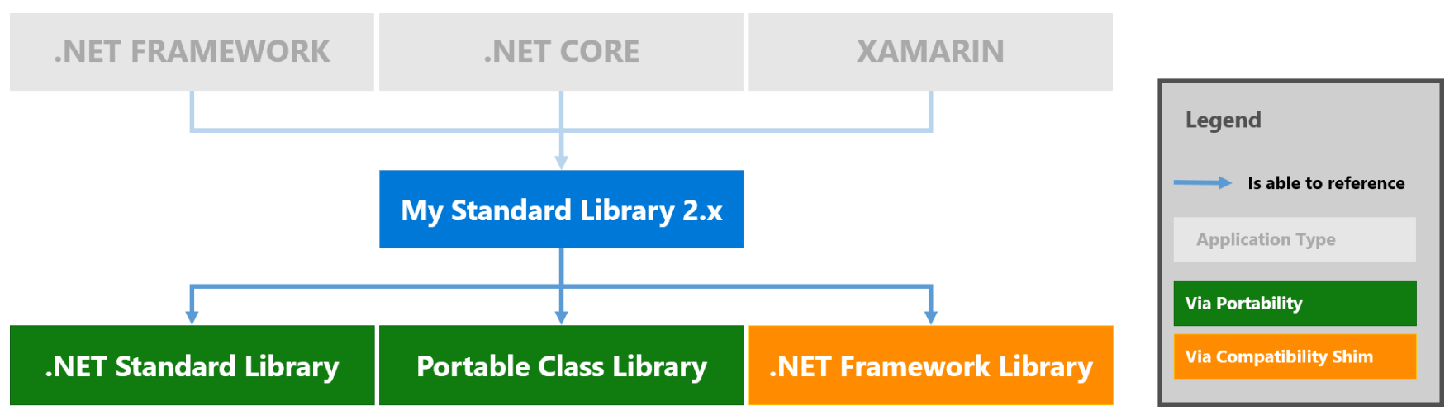
What is .NET Standard?
.NET Standard is a specification, not an implementation
.NET Standard provides a common base .NET Interface to all platforms that implement it so that no matter which version of .NET you use you'll always see at least the same base feature set.
.NET Standard describes what a specific implementation like .NET Core, Mono, Xamarin or .NET 4.6 has to implement - at minimum - in terms of API surface in order to be compliant with a given version of .NET Standard.

Slide 5
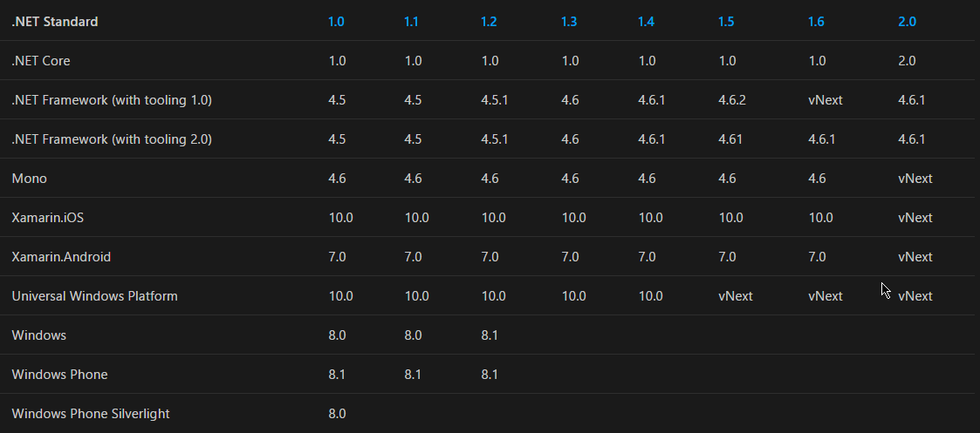
.NET platforms support
The following table lists all versions of .NET Standard and the platforms supported:
The higher the version, the more APIs are available to you. The lower the version, the more platforms implement it.
https://docs.microsoft.com/en-us/dotnet/api (see also https://apisof.net)

Slide 6
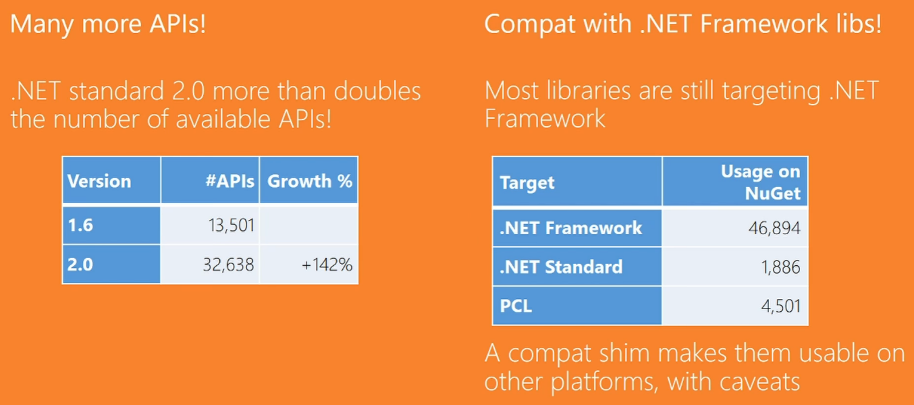
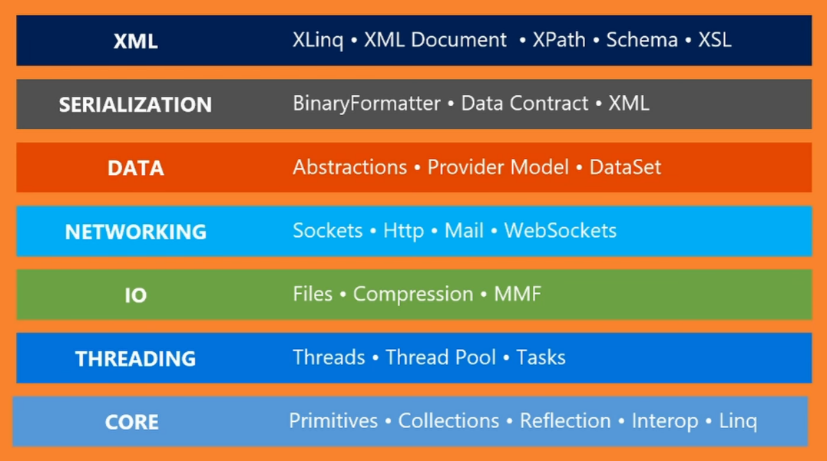
What’s new in .NET Standard 2.0

Slide 7
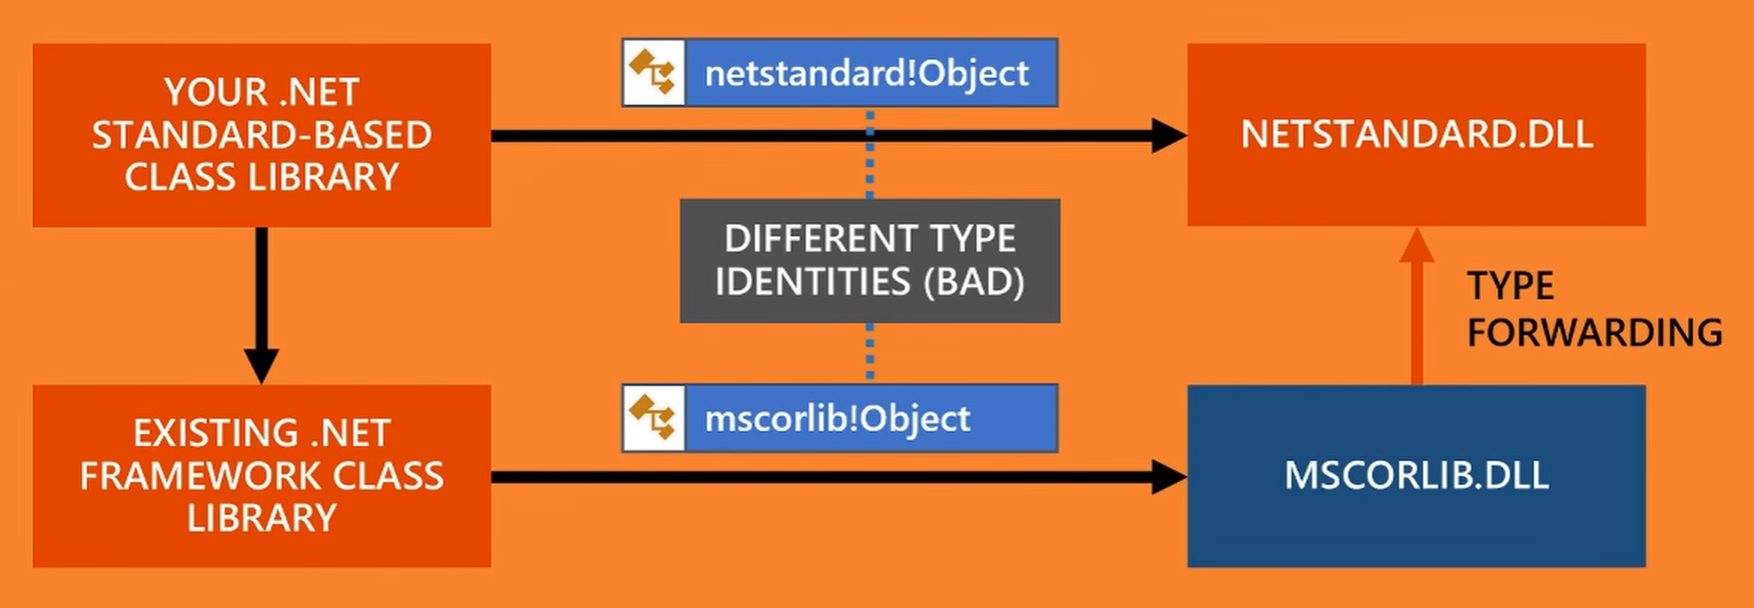
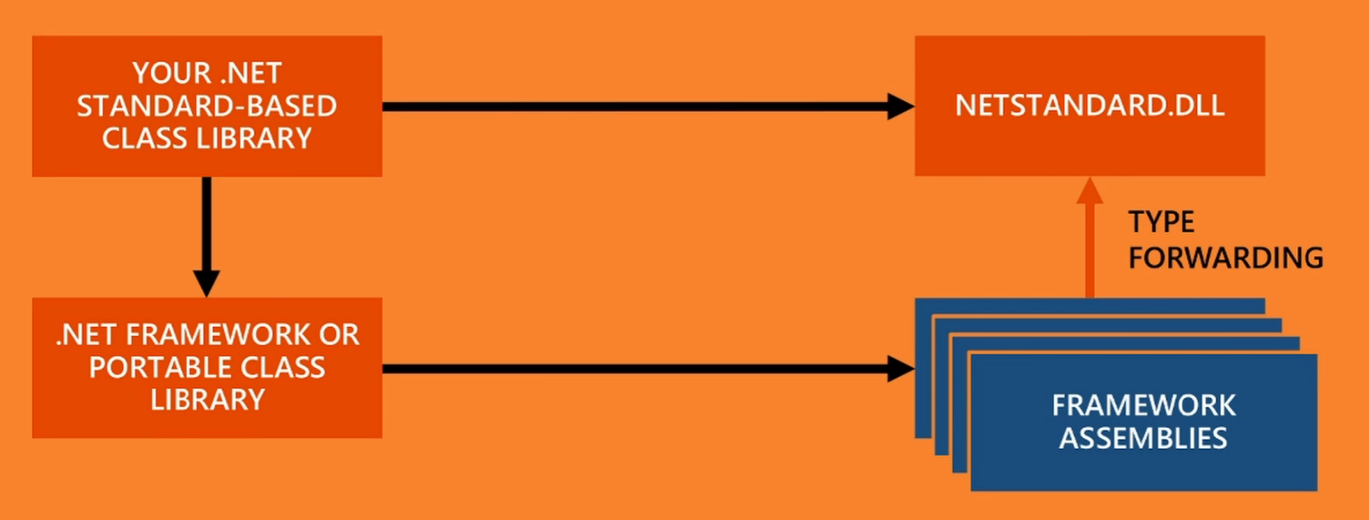
.NET Standard under the hood
When .NET Standard class library references .NET Framework library it uses special version of mscorlib.dll that translates types from .NET Framework to .NET Standard
Type forwarding is done for each .NET Framework assembly

Slide 8
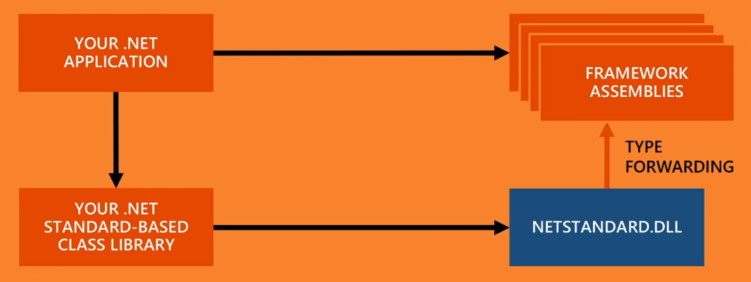
.NET Standard under the hood
When specific .NET runtime, e.g. .NET Core class library references .NET Standard library it uses special version of netstandard.dll that translates types from .NET Standard to .NET Core

Slide 9
Migrating to .NET Standard
.NET Portability Analyzer – plugin to Visual Studio
https://github.com/Microsoft/dotnet-apiport

Slide 10
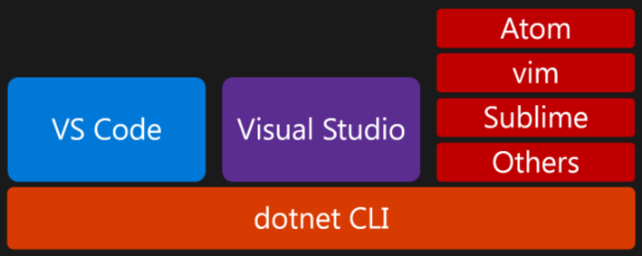
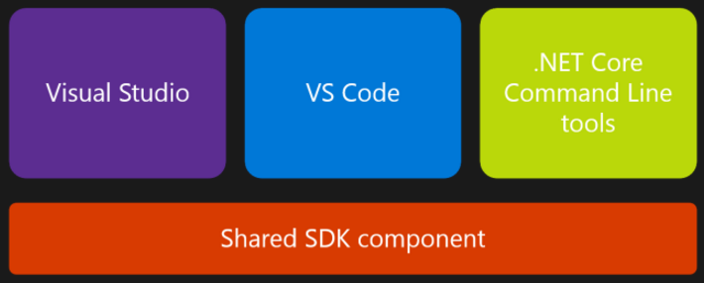
What’s new in .NET Core?
.NET Core 1.1 released
Official release of .NET Core tools (with change in the tooling layers)
This shared SDK component is a set of MSBuild targets and associated tasks that are responsible for compiling your code, publishing it, packing NuGet packages etc.
Moving away from project.json to .csproj
CLI commands are translated to MSBuild invocations.
Visual Studio invokes MSBuild directly

Slide 11
What’s new in Visual Studio 2017

Slide 12
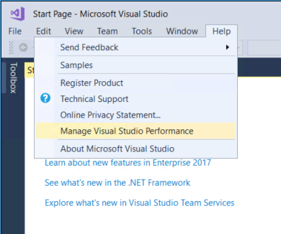
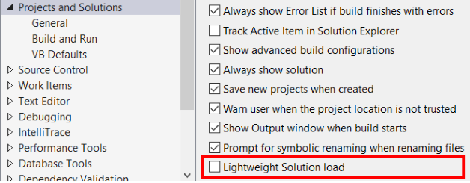
Performance improvements
A new setup experience
Start Visual Studio faster (The Performance Center lists all the extensions and tool windows that might slow down the IDE startup)
Decrease solution load time
Faster on-demand loading of extensions

Slide 13
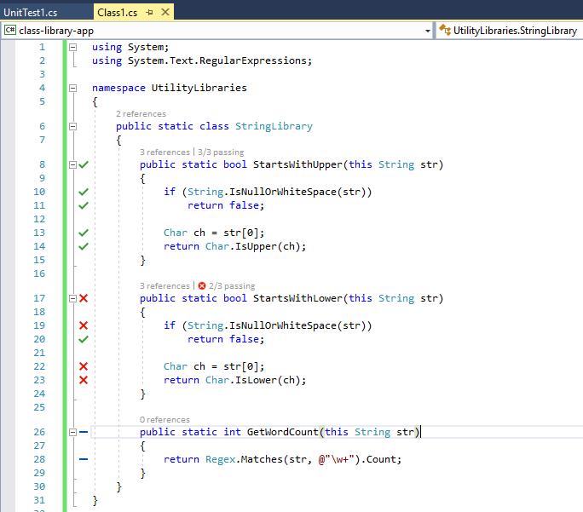
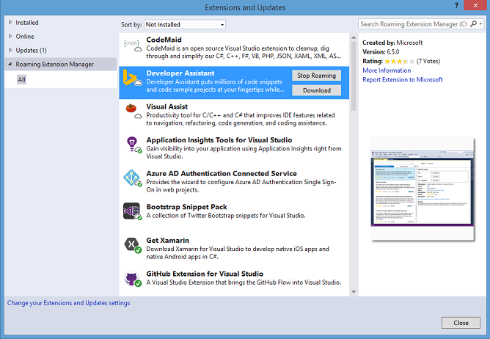
Productivity improvements
Manage your extensions with Roaming Extensions Manager
When you use the Roaming Extension Manager, you will notice 3 icon types on your list: Roamed, Roamed & Installed, Installed
Live architecture dependency validation
Live Unit Testing

Slide 14
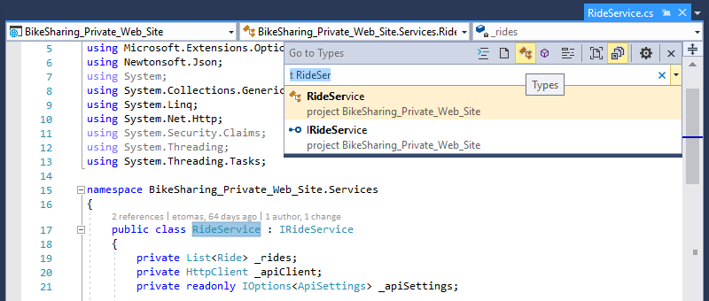
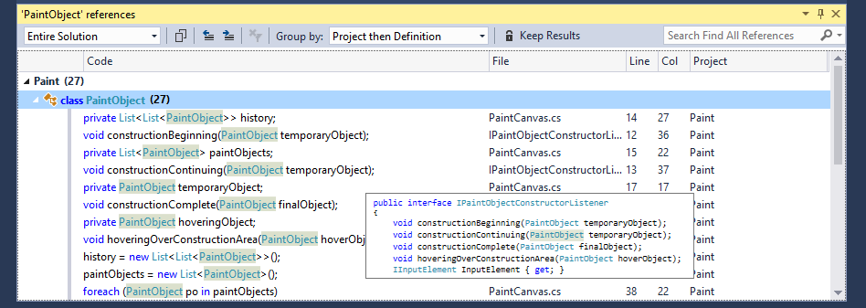
Visual Studio IDE enhancements
View and navigate code with Structure Visualizer
Experience improved navigation controls
Go To (Ctrl+F12) – navigate from any base type or member to its various implementations.
Go To All (Ctrl+T or Ctrl+,) – navigate directly to any file/type/member/symbol declaration. You can filter your result list or use the query syntax (for example, “f searchTerm” for files, “t searchTerm” for types, etc.).
Find All References (Shift+F12) – with syntax colorization, you can group Find All Reference results by a combination of project, definition, and path. You can also “lock” results so that you can continue to find other references without losing your original results.
Indent Guides – dotted, gray vertical lines act as landmarks in code to provide context within your frame of view.
Live edit and reload of .csproj file

Slide 15
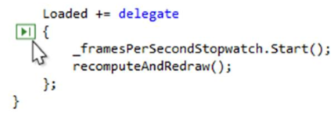
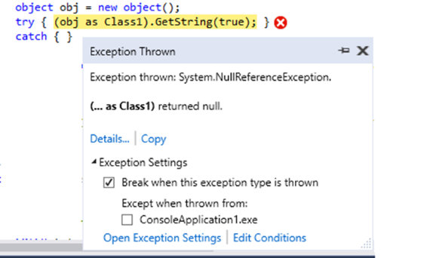
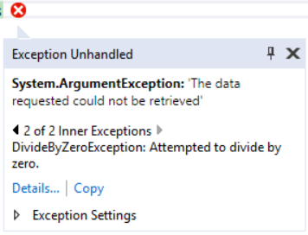
Debugging and Diagnostics
Run to Click
New Exception Helper

Slide 16
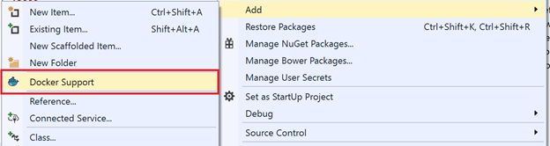
Docker Containers support
Develop, Run, Debug, Update your Web & Console Applications in a Docker Container
Multi-container debugging
Edit & Refresh of code
Publish to Azure App Service

Slide 17
What’s new in C# 7.0

Slide 18
New C# language features
out variables
Tuples
Pattern Maching
ref locals and returns
Local Functions
More expression-bodied members
throw Expressions
Generalized async return types
Numeric literal syntax improvements

Slide 19
out variables
Previously, you would need to separate the declaration of the out variable and its initialization into two different statements:
int numericResult;
if (!int.TryParse(input, out numericResult))
{
return 0;
}
return numericResult;
You can now declare out variables in the argument list of a method call, rather than writing a separate declaration statement:
if (!int.TryParse(input, out var numericResult))
{
return 0;
}
return numericResult;
The code is easier to read.
No need to assign an initial value.
Support for explicit type as well as var

Slide 20
Tuples creation
Unnamed tuple:
var unnamed = ("one", 10);
Console.WriteLine(unnamed.Item1 + unnamed.Item2);
Named tuple:
var named = (First: "one", Second: 10);
Console.WriteLine(named.First + named.Second);
(string First, int Second) named = ("one", 10);
Console.WriteLine(named.First + named.Second);
(string First, int Second) named = (A: "one", B: 10);
Console.WriteLine(named.First + unnamed.Second);
The new tuples features require the System.ValueTuple type. It can be referenced via NuGet.

Slide 21
Tuples as method return values
Methods can return tuple results:
private (string First, int Second) GetResult()
{
string first = "one";
int second = 10;
return (first, second);
}
private (string First, int Second) GetResult()
{
var result = (First: "one", Second: 10);
return result;
}
private (string First, int Second) GetResult()
{
var result = new Tuple<string, int>("one", 10);
return result; //THIS WILL NOT COMPILE
}
private (string First, int Second) GetResult()
{
var (first, second) = new Tuple<string, int>("one", 10);
return (first, second);
}
Method result can be assigned to single value or deconstructed:
var result = GetResult();
Console.WriteLine(result.First + result.Second);
(double first, var second) = GetResult();
Console.WriteLine(first + second);

Slide 22
Tuples as method return values
Methods can return generic types with tuple:
private IEnumerable<(string First, int Second)> GetResult()
{
yield return ("one", 10);
}
IEnumerable<(string First, int Second)> result = GetResult();
IEnumerable<(string, int)> result2 = GetResult();
var result3 = GetResult();
As well as array of tuple values:
private (string First, int Second)[] GetResult()
{
return new (string, int)[] {("one", 10)};
}
(string First, int Second)[] result = GetResult();
(string, int)[] result2 = GetResult();
var result3 = GetResult();

Slide 23
Tuples - deconstruction
Reconstructing a tuple:
(string first, int second) = GetTupleResult();
var (first, second) = GetTupleResult();
Deconstructing user defined types:
Deconstructing using extension method:
public class Person
{
public string FirstName { get; }
public string LastName { get; }
public void Deconstruct(out string firstName, out string lastName)
{
firstName = FirstName;
lastName = LastName;
}
}
public static class PersonExtensions
{
public static void Deconstruct(this Person person,
out string firstName, out string lastName)
{
firstName = person.FirstName;
lastName = person.LastName;
}
}
var p = new Person("Althea", "Goodwin");
var (first, last) = p;

Slide 24
Pattern Matching
is operator:
The is type pattern expression:
if (shape is Square)
{
var s = shape as Square;
return s.Side * s.Side;
}
if (shape is Square s)
{
return s.Side * s.Side;
}
Pattern matching switch statement :
switch (shape)
{
case 0:
return 0;
case int val:
return val^2;
case Square s when s.Side == 0:
case Triangle t when t.Base == 0 || t.Height == 0:
return 0;
case Square s:
return s.Side * s.Side;
case Triangle t:
return t.Base * t.Height * 2;
case null:
throw new ArgumentNullException(nameof(shape));
default:
throw new ArgumentException(nameof(shape));
}
The order of the case expressions now matters.
If you accidentally order match expressions such that a less explicit case has already been handled, the compiler will flag that and generate an error.
The default case is always evaluated last, regardless of the order it appears in the source.

Slide 25
ref locals and returns
Just like you can pass things by reference (with the ref modifier) in C#, you can now return them by reference, and also store them by reference in local variables.
public static ref int Find(int number, int[] numbers)
{
for (int i = 0; i < numbers.Length; i++)
{
if (numbers[i] == number)
{
return ref numbers[i]; // return the storage location, not the value
//return numbers[i]; // this will not compile
}
}
throw new InvalidOperationException("Not found");
}
int[] array = { 1, 15, -39, 0, 7, 14, -12 };
ref int place = ref Find(7, array); // gets reference to 7's place in the array
place = 9; // replaces 7 with 9 in the array
Console.WriteLine(array[4]); // prints 9
You could only accomplish this by using unsafe code and returning a pointer to an int in previous versions.
When you declare that a method returns a ref variable, you must also add the ref keyword to each return statement. That indicates return by reference, and helps developers reading the code later remember that the method returns by reference.

Slide 26
ref locals and returns
The variable place is an int, not a ref int. The var keyword enables the compiler to specify the type, but will not implicitly add the ref modifier. Instead, the value referred to by the ref return is copied to the variable on the left-hand side of the assignment. The variable is not a ref local.
var place = Find(7, array); // in this case 7 is printed
int place = Find(7, array); // in this case 7 is printed
var place = ref Find(7, array); // this will not compile
ref int place = Find(7, array); // this will not compile
You must initialize a ref variable when it is declared, you cannot split the declaration and the initialization.

Slide 27
ref locals and returns
The C# language has two other rules that protect you from misusing the ref locals and returns:
You cannot assign a value to a ref variable. That disallows statements like
ref int i = sequence.Count();
You cannot return a ref to a variable whose lifetime does not extend beyond the execution of the method. That means you cannot return a reference to a local variable, or similar scope.
These rules ensure that you cannot accidentally mix value variables and reference variables. They also ensure that you cannot have a reference variable refer to storage that is a candidate for garbage collection.

Slide 28
Local functions
Used in public iterator methods:
public static IEnumerable<char> AlphabetSubset(char start, char end)
{
if ((start < 'a') || (start > 'z'))
throw new ArgumentOutOfRangeException(paramName: nameof(start), message: "start must be a letter");
if ((end < 'a') || (end > 'z'))
throw new ArgumentOutOfRangeException(paramName: nameof(end), message: "end must be a letter");
if (end <= start)
throw new ArgumentException($"{nameof(end)} must be greater than {nameof(start)}");
return AlphabetSubsetImplementation();
IEnumerable<char> AlphabetSubsetImplementation()
{
for(var c = start; c < end; c++)
yield return c;
}
}
When checks and logic are in the same method exceptions are not thrown when method is invoked, but only when result is iterated (because it is iterator method)
When checks are in public method and logic in private then exceptions are thrown when the method is invoked (because it is no longer an iterator method), but programmer is able to invoke private method without checks
When logic is in local function then exception is thrown when method is invoked and programmer is not able to invoke logic from local function without checks

Slide 29
Local functions
Used for async methods:
public Task<string> PerformLongRunningWork(string address, int index, string name)
{
if(string.IsNullOrWhiteSpace(address))
throw new ArgumentException(message: "An address is required", paramName: nameof(address));
if (index < 0)
throw new ArgumentOutOfRangeException(paramName: nameof(index), message: "The index must be non-negative");
if (string.IsNullOrWhiteSpace(name))
throw new ArgumentException(message: "You must supply a name", paramName: nameof(name));
return LongRunningWorkImplementation();
async Task<string> LongRunningWorkImplementation()
{
var interimResult = await FirstWork(address);
var secondResult = await SecondStep(index, name);
return $"The results are {interimResult} and {secondResult}. Enjoy.";
}
}
Without local function exception is thrown asynhronously as part of the awaitable
With use of local function exceptions arising from argument validation are thrown before the asynchronous work begins

Slide 30
Local functions compared to Lambda expressions
There are a number of reasons to prefer using local functions instead of defining and calling lambda expressions:
For lambda expressions, the compiler must create an anonymous class and an instance of that class to store any variables captured by the closure.
Lambda expressions are implemented by instantiating a delegate (extra memory allocation) and invoking that delegate.
Lambda expressions must be declared before they are defined. This means local functions are easier to use in recursive algorithms.
public static int LocalFunctionFactorial(int n)
{
return NthFactorial(n);
int NthFactorial(int number) => (number < 2) ? 1 : number * NthFactorial(number - 1);
}
public static int LambdaFactorial(int n)
{
Func<int, int> nthFactorial = default(Func<int, int>);
nthFactorial = (number) => (number < 2) ? 1 : number * nthFactorial(number - 1);
return nthFactorial(n);
}

Slide 31
More expression-bodied members
// Expression-bodied constructor
public ExpressionMembersExample(string label) => this.Label = label;
// Expression-bodied finalizer
~ExpressionMembersExample() => Console.Error.WriteLine("Finalized!");
private string label;
// Expression-bodied get / set accessors.
public string Label
{
get => label;
set => this.label = value ?? "Default label";
}

Slide 32
Throw expressions
string result = argument ?? throw new ArgumentNullException(nameof(argument));
string result = items.Length > 0 ? items[0] : throw new ArgumentException("items argument should have at least 1 element");
private string GetName() => throw new NotImplementedException();

Slide 33
Generalized async return types
Methods declared with the async modifier can return other types in addition to Task, Task<T> and void
public ValueTask<int> CachedFunc()
{
return (cache) ? new ValueTask<int>(cacheResult) : new ValueTask<int>(LoadCache());
}
private bool cache = false;
private int cacheResult;
private async Task<int> LoadCache()
{
// simulate async work:
await Task.Delay(100);
cache = true;
cacheResult = 100;
return cacheResult;
}
Returning a Task object from async methods can introduce performance bottlenecks because of allocating memory for Task which is a reference type.
The returned type must still satisfy the async pattern, meaning a GetAwaiter method must be accessible.
ValueTask type has been added to the .NET framework to make use of this new language feature. It can accept a result or Task in constructor.

Slide 34
Numeric literal syntax improvements
The 0b at the beginning of the constant indicates that the number is written as a binary number.
public const int One = 0b0001;
public const int Eight = 0b1000;
public const int Sixteen = 0b0001_0000;
public const int OneHundredTwentyEight = 0b1000_0000;
public const long BillionsAndBillions = 100_000_000_000;
public const double AvogadroConstant = 6.022_140_857_747_474e23;
public const decimal GoldenRatio = 1.618_033_988_749_894_848_204_586_834_365_638_117_720_309_179M;
Binary numbers can get very long, so it's often easier to see the bit patterns by introducing the _ as a digit separator.
The digit separator can appear anywhere in the constant. For base 10 numbers, it would be common to use it as a thousands separator.
The digit separator can be used with decimal, float and double types as well.

Slide 35
Thank you

